Slide 1
IGIU Memorial Hackathon 2024
SAHAY
Augmented Value

Slide 2

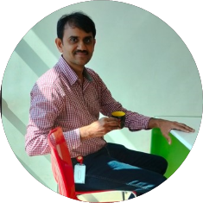
Meet the team
Rohit Lingala
Chandra Perni
Project Lead
Project Co Lead
Integration Engineer
Senior Manager, Product Development - Integrations

Slide 3

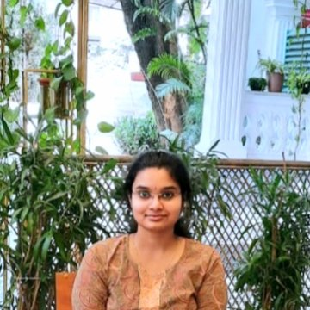
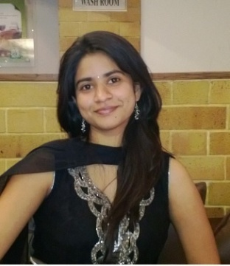



Meet the team
Yojitha Sai Lakshmi Chavva
Sri Vaishnavi Balijepalli
Sumalatha Gokula
Team Member Applications Engineer
Team Member Senior Applications Engineer
Team Member Senior Principal Applications Engineer
Mahboob Ali
Gundaram Rohith
Sai Bhanu Revanth Vazrapu
Team Member Associate Applications Developer
Team Member Applications Developer
Team Member Associate Applications Developer

Slide 4




Meet the team
Kajal Goyal
Deepti Ravi Kumar
Team Member Senior Applications Engineer
Team Member Associate Applications Developer
Sai Sreevalli Keerti Kopalle
Sai Kumar Banala
Team Member Applications Engineer
Team Member Senior Applications Engineer

Slide 5
Project Summary
As a customer of OUAF Edge App, do you have any functional questions while working on a flow?
Are you tired of writing complex SQL queries to fetch data?
If yes, then
Say Hi to our “Sahay”, an AI-powered chatbot that revolutionizes the way users interact with data and resolve functional questions.
Effortless Assistance: Sahay is integrated directly into the OUAF Edge Application, offering instant, real-time solutions to user questions with intuitive, conversational responses.
No More SQL Hassles: Leveraging advanced natural language processing, Sahay enables users to access and query product data using simple, everyday language—eliminating the need for technical expertise.
Empowering Self-Service: Sahay empowers users to independently find answers, reducing reliance on customer support and significantly improving response times.
Enhancing Productivity & Satisfaction: By reducing the need for manual intervention, Sahay improves customer satisfaction, increases operational efficiency, and lightens the load on support teams.
Sahay isn't just a chatbot; it's a game-changer. It transforms the OUAF Edge App user experience, combining AI-driven innovation with human-like interaction to create a support system that's as powerful as it is intuitive.
Notes:
Tell us about your project. What problem or opportunity have you identified? What solution are you proposing?
Don’t forget to highlight why this is important. If you’ve chosen a theme that’s focused on our customer, it must talk to the customer value.
Or for themes that are internally focused, talk about why it’s valuable for your colleagues.

Slide 6


User Goal
As a new CCB Customer, I need more information about Collection Process so that I can get deeper understanding of CCB.
As a Customer Support Representative, I need to navigate to multiple portals so that I can retrieve billing information of a customer.
Ken
CCB Customer
Kendal
CSR
IGIU
Notes:
A good user goal is…
Solution agnostic
Explores multiple ideas
Durable over time
Broad enough to be broken down into many smaller tasks
User = Who are you solving a problem for?
Goal = What are they trying to achieve?
Motivation = Why do they need to accomplish this goal?

Slide 7
Shape of Data
Question
Answer
What’s the Duration of the Session in minutes?
What’s the Frequency of User Queries per hour?
What’s the Total Number of Conversations held?
What’s the Response Time for User questions?
What’s the Total Time Saved by users each week?
What’s the Number of Active Users who use the chatbot?
What’s the Number of Apps in which the chatbot can be integrated into?
Between 3min and 20min, but typically 10min.
Between 50 and 2000, but typically 1000
Between 5 messages and 20 messages, but typically 10 messages
Between 1 sec and 5 sec, but typically 2sec
Between 2 hours and 6 hours, but typically 4 hours.
Between 100 and 3000, but typically 1500.
Between 15 and 50, but typically 25.
Assumption

Slide 8
How Might We?
Idea A
Idea B
Idea C
Review all the documents available to understand a specific functionality. Connect to the database manually and create complex queries to retrieve the necessary data.
Contact the subject matter experts (SMEs) to learn about specific functionalities of the product. Their expertise will help clarify details and provide a better understanding of how the product works.
Contact customer support to submit a ticket for assistance in understanding the functionality. This will ensure you receive the necessary guidance and clarification regarding any questions you have.
Idea D
Develop a chatbot that can address functional questions and retrieve data from the database using simple English sentences.

Slide 9

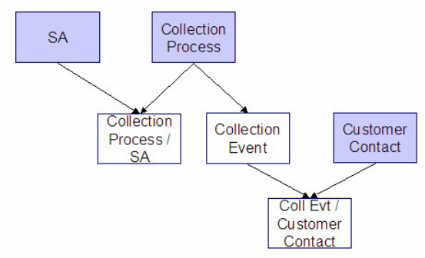



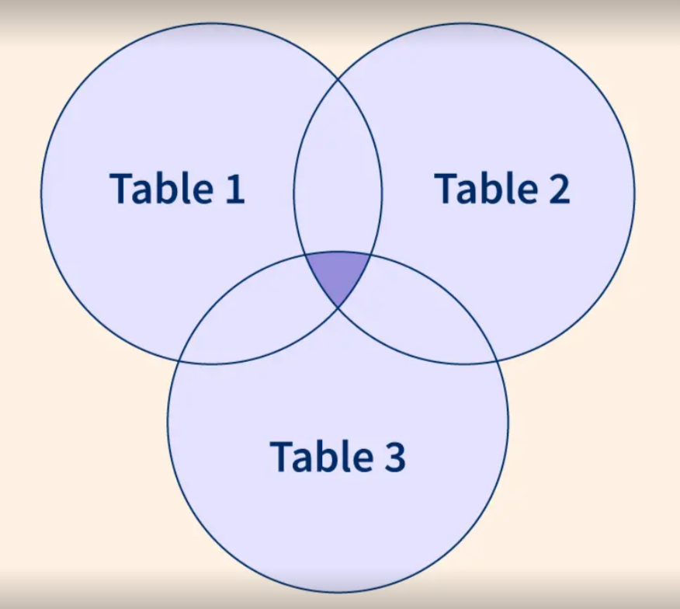


Current State
BCKWJ
After 2 exhausting hours, he finds what he needs and wonders if there was an easier way.
Ken wants to learn about collection processes in the CCB system.
He begins reading through a vast array of functional documents, one after the other.
Soon, he feels overwhelmed by the sheer volume of information.
Then, she connects to the CCB database and forms a complex query joining multiple tables to get the information
Kendal wants to find out how many bills are due for a person John in the CCB system.
She logs into the application and identifies the tables that contain this information.
Once finished, she ponders whether there was a simpler solution to get the data.

Slide 10
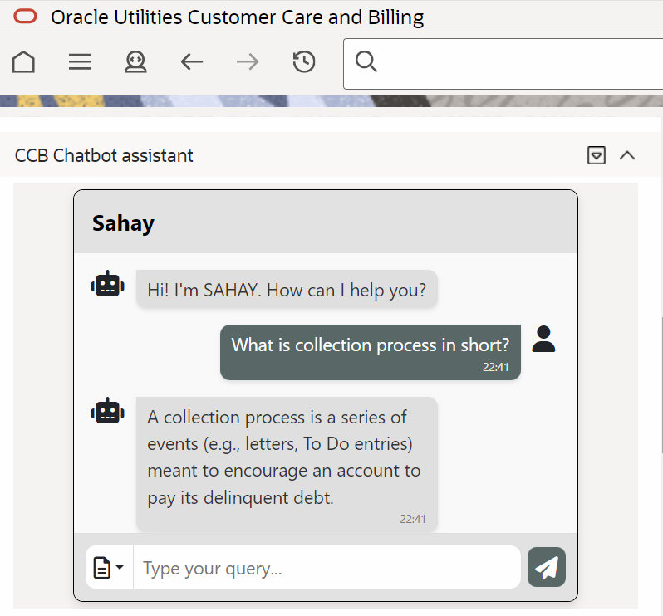

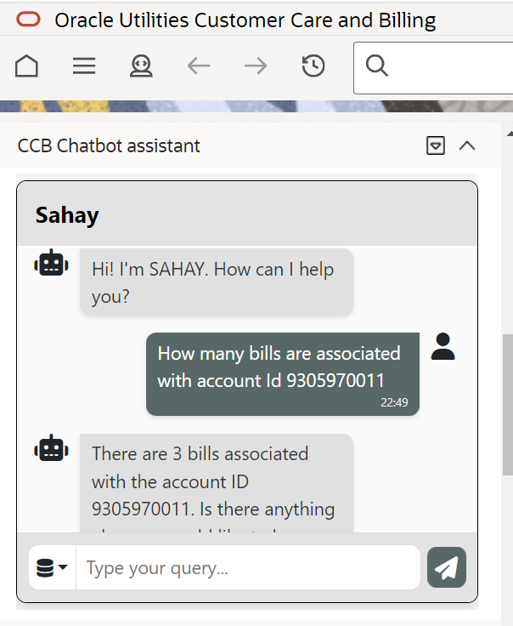

Future State
Ken wants to learn about collection processes in the CCB system.
Ken initiates a conversation with ‘Sahay’ present in CCB application. He asks all his functional questions to gather information related to collection process.
Ken wants to learn about collection processes in the CCB system.
Ken is pleased to have received the information so promptly.
Kendal is thrilled to have received the information right away without having to write a complicated SQL query.
Kendal starts a dialogue with the chatbot ‘Sahay’ which is integrated within CCB application and asks her query in simple English language.
Kendal wants to find out how many bills are due for a person named John in the CCB system.
Kendal is thrilled to have received the information right away without having to write a complex SQL query.

Slide 11



Market Opportunity
10%
Projected Market Size:
Total Addressable Market (TAM): $5 billion in AI-driven customer support solutions.
Revenue Potential: Capturing 10% of this market could yield $500 million annually.
Differentiation:
A unique combination of a vector database and RAG to answer functional queries and resolve issues, tailored specifically for the OUAF Edge App.
Metric KPI:
Increase in Customer Satisfaction Score (CSAT) by 30%.
Reduction in support tickets related to functional queries and bugs by 40%.
Total Addressable Market
$500 million
Revenue Potential
Metric
KPI
Notes:
Potential metrics:
Cost
Time
Error reduction
Accuracy
Safety
Health or well-being
Profit

Slide 12
Competitive Analysis
IBM Watson Assistant
Microsoft Power Virtual Agents
Zendesk Chat
Strengths: Robust NLP and context handling
Opportunities: Complex setup, lacks specific integrations for niche applications
Strengths: Easy integration with other Microsoft services and strong analytics features for tracking performance
Opportunities: Primarily geared towards general business applications, may require extensive customization to effectively handle SQL query assistance and specific product knowledge
Strengths: General customer support and ease of use.
Opportunities: Limited functionality for technical queries, not designed for bug resolution

Slide 13
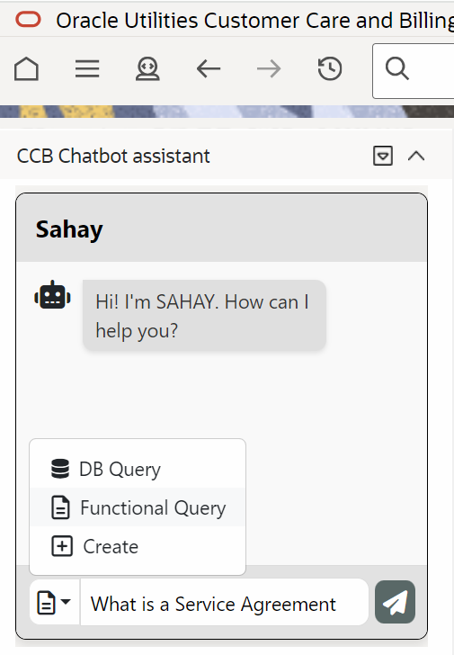
Demo

Slide 14


Slide 15
What’s Next?
Assign customer support professionals to address bugs or issues that require immediate attention, or automatically raise SRs
Establish a scheduling system to ensure the chatbot is updated with the latest information
Customers should be empowered to configure their own LLM
Ability to create workflow data directly through the chatbot
Integrate audio to chatbot
Accept customer feedback

Slide 16
Summary
Sahay assists customers with any functional questions and provides real-time support with interactive responses.
The chatbot helps the users in accessing information from the product database using simple sentences, eliminating the need for writing intricate SQL queries.
It can handle routine functional queries , thereby reducing support workload.
This chatbot can be integrated with any OUAF Edge application, ensuring OUAF users get assistance anytime.

